Slide 1
H₂OW LOW
...can you go?
Veronica | Nico | Matthew | Jane

Slide 2
Overview
Low-fi prototype of H₂OW Low? UI
Using POP as a prototyping tool
UI testing scenarios
Experiment method and results

Slide 3
Mission Statement
Our mission is to provide a means of accurately tracking water usage on personal and aggregate levels, as well as a source of external motivation to conserve.

Slide 4
Representative tasks
Track personal water usage data
Join conservation competition
Visualize population water patterns

Slide 5
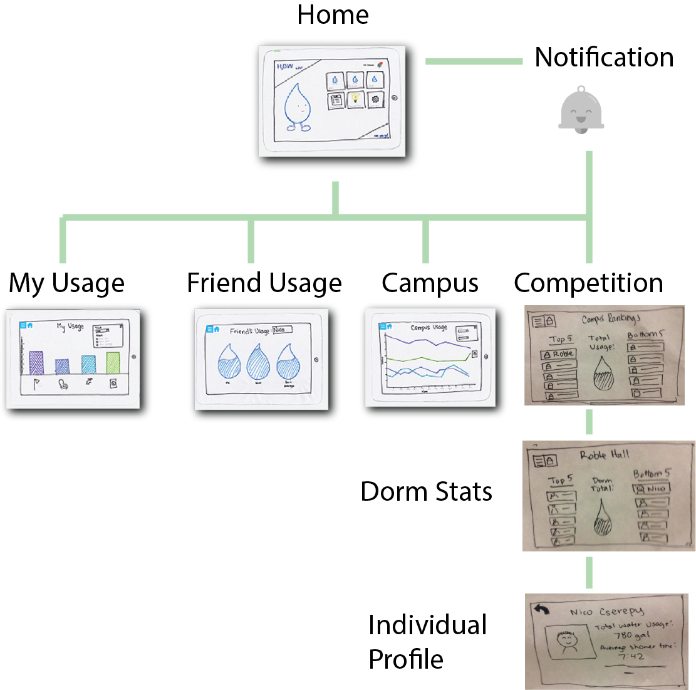
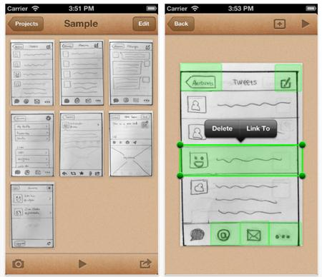
Lo-fi prototype structure
Prototype on Paper

Slide 6
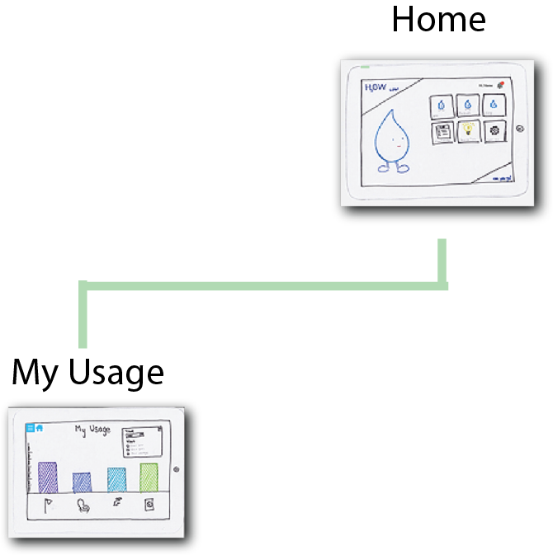
Task 1: Track personal water usage data

Slide 7
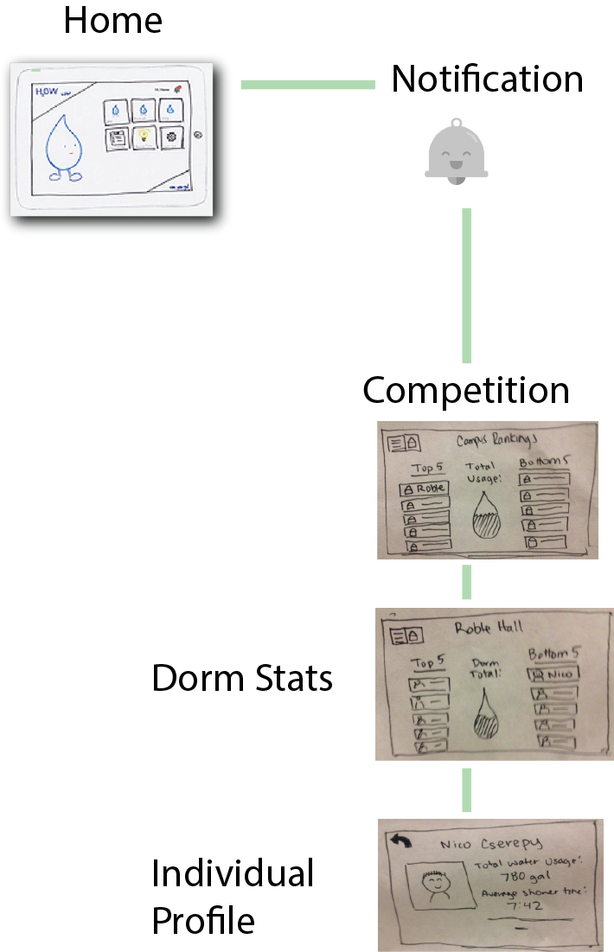
Task 2: Join conservation competition

Slide 8
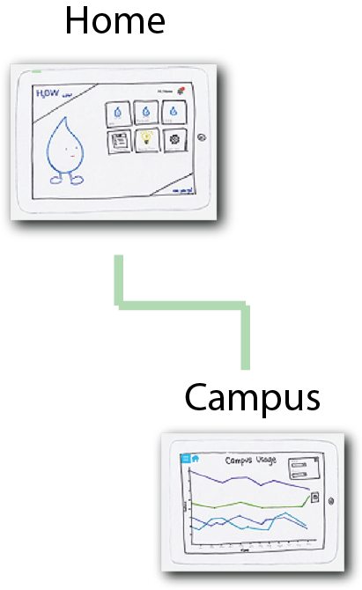
Task 3: Visualize population water patterns

Slide 9
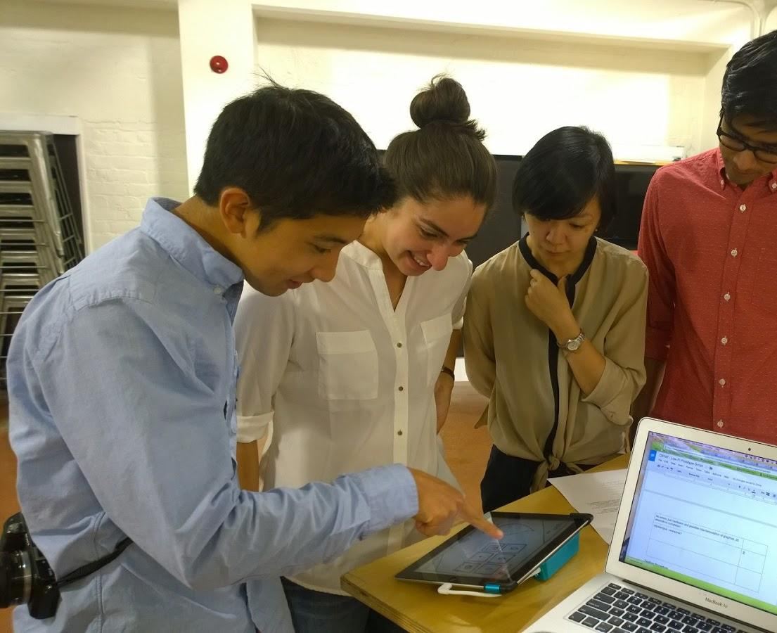
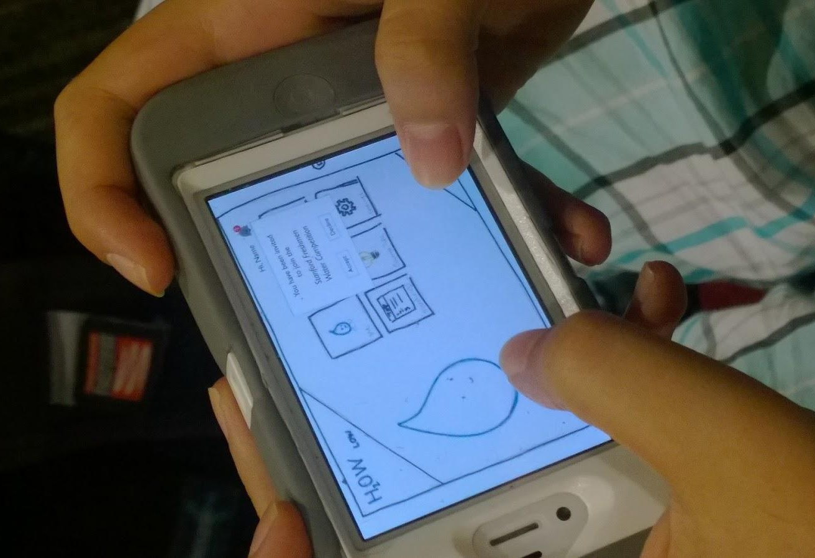
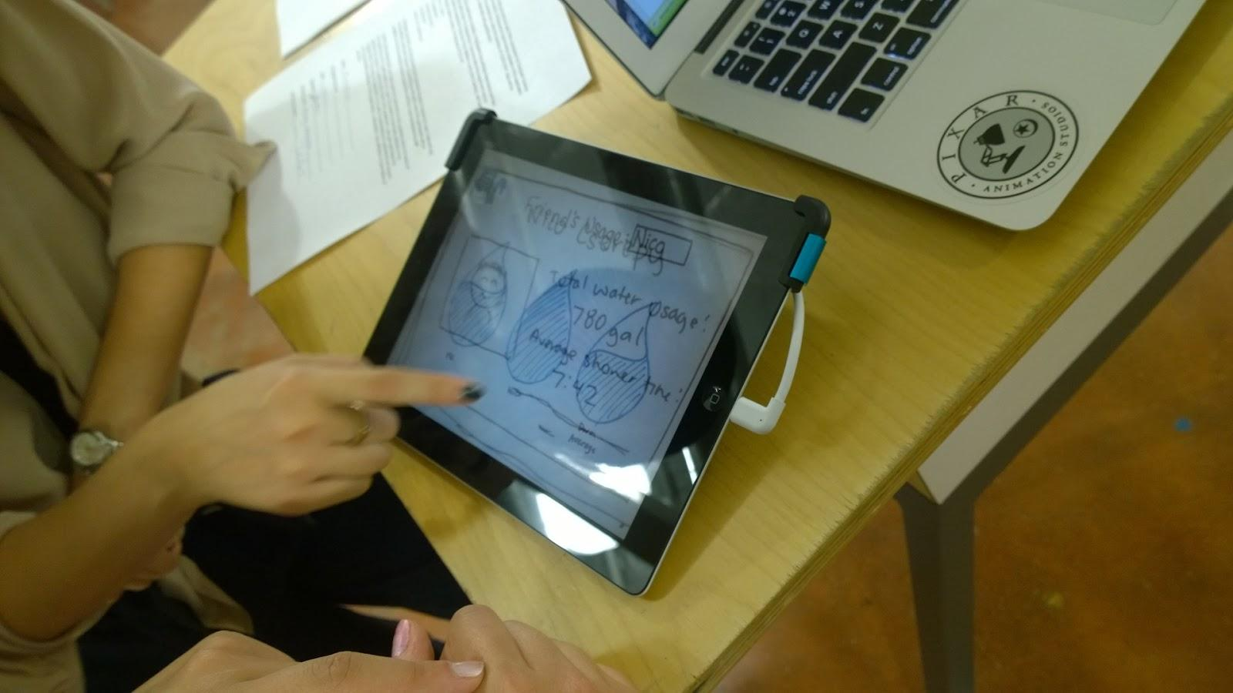
Experimental method

Slide 10
Experimental results
Hesitation in finding notification
Confusion with redirect after accepting invitation.

Slide 11
Experimental results cont.
Ambiguous “City” label
Trouble identifying difference between “Campus Competition” and “City Statistics”

Slide 12
Suggested UI changes
main screen should be more visual (ex. friend screen)
Hi Name/notification icon should be on every page
rename city to be more inclusive
more creation/initiation - mostly about receiving data right now
integrate tips

Slide 13
Summary
Designed UI prototype
Created test method
Conducted interviews
Gathered results:
bold important features
clear labeling
creation capabilities

